Slide 1
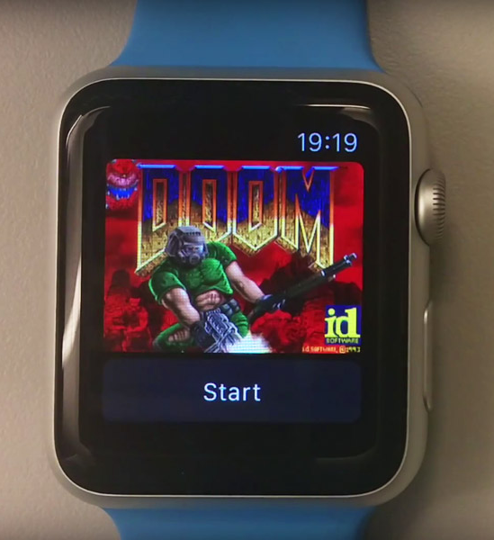
X-Platform .NET
@PeteSamuel

Slide 2
Agenda
Background
Workshop
Why?
.NET Core and .NET Standard
What does this enable
Use cases
Cross platform
Android
iOS
Linux
Windows
Write a .NET Standard Class Library
Implement this in
Android
iOS
Deploy a version of the same code to Azure

Slide 3

Disclaimer
Noob alert
https://flic.kr/p/JjZkxW

Slide 4
Why?
Re-use skills
Re-use code
Write C# code that can run on multiple platforms
Deliver faster
Unification
No need to recompile to target new/different platforms

Slide 5
.NET Standard is a Specification
Like an interface for Base Class Libraries

Slide 6
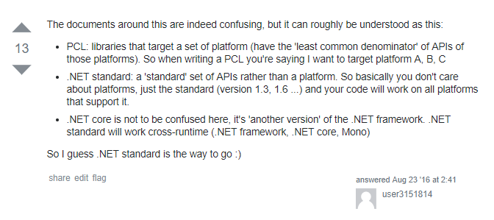
What was wrong with Portable Class Libraries (PCL)?
https://stackoverflow.com/questions/39050911/net-standard-net-core-pcl

Slide 7
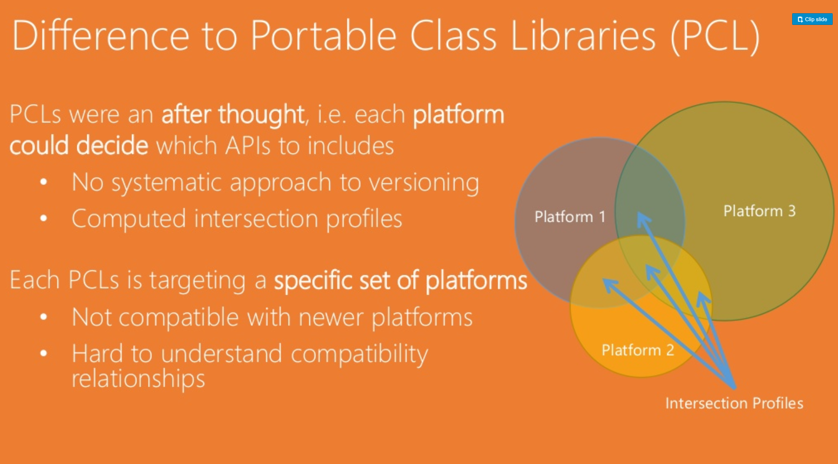
https://www.slideshare.net/terrajobst/net-standard-introduction

Slide 8
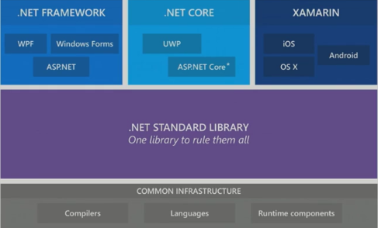
How does this work?

Slide 9
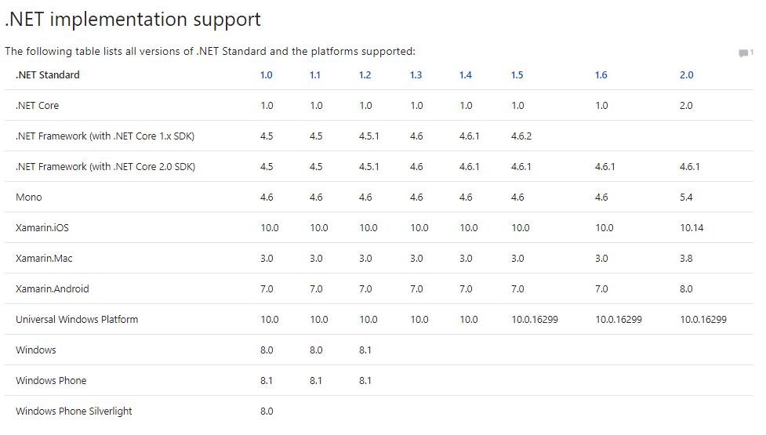
Versioning
https://docs.microsoft.com/en-us/dotnet/standard/net-standard

Slide 10
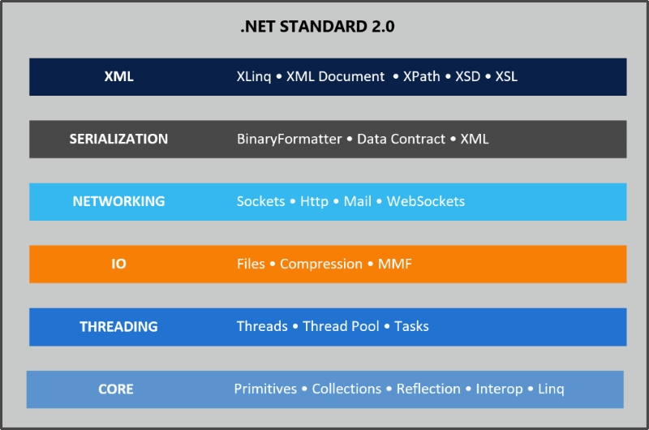
V2.0
Better compatability with more APIs
Easier to port code
Compatability Shim available
Can consume libraries not written in .NET standard
PCL
.csproj ☺
Nice and clean!
https://weblog.west-wind.com/posts/2016/Nov/23/NET-Standard-20-Making-Sense-of-NET-Again

Slide 11
.NET Standard Use Cases
Good for
Not suitable for
Nuget packages have to support this going forward
Business logic layer
Models
FINT Project
E.g. NServiceBus running on .NET Core?
If you need feature not yet implemented in .NET Standard

Slide 12
Xamarin Use Cases
Good for
Not suitable for
Proof of Concepts
Wireframing
MVP
Fast time to market
High code re-use across platforms
High Performance Applications

Slide 13
FAQs First time running this so feedback please!
What is required to produce an Android App?
Deploy to iOS?

Slide 14
Workshop Tooling
PC
Mac
Visual Studio
Android Studio
SDK Manager
Emulators
Visual Studio for Mac
Xcode
Android Studio

Slide 15
References
https://github.com/pjsamuel3/xPlatformDotNet
https://blog.xamarin.com/building-xamarin-forms-apps-net-standard/
https://www.xamarin.com/prebuilt - using PCL but now we can port
https://docs.microsoft.com/en-us/dotnet/standard/net-standard#comparison-to-portable-class-libraries
https://github.com/jeremylindsayni/RaspberryPi.Template
.NET Standard Video Introductions from the creator

Slide 16
DEMO
https://github.com/pjsamuel3/xPlatformDotNet/releases
Browse the repro if you like to skip to specific points in my research
File > New Project = v1.0.0
git clone https://github.com/pjsamuel3/xPlatformDotNet.git
git checkout -b 0.0.0 0.0.0
git checkout -b 2.0.0 2.0.0
git checkout -b 3.0.0 3.0.0
git checkout -b 3.1.0 3.1.0
git checkout -b 3.2.0 3.2.0

